Slide 1
Lecture : 4 Mechanics & Gravitation

Slide 2
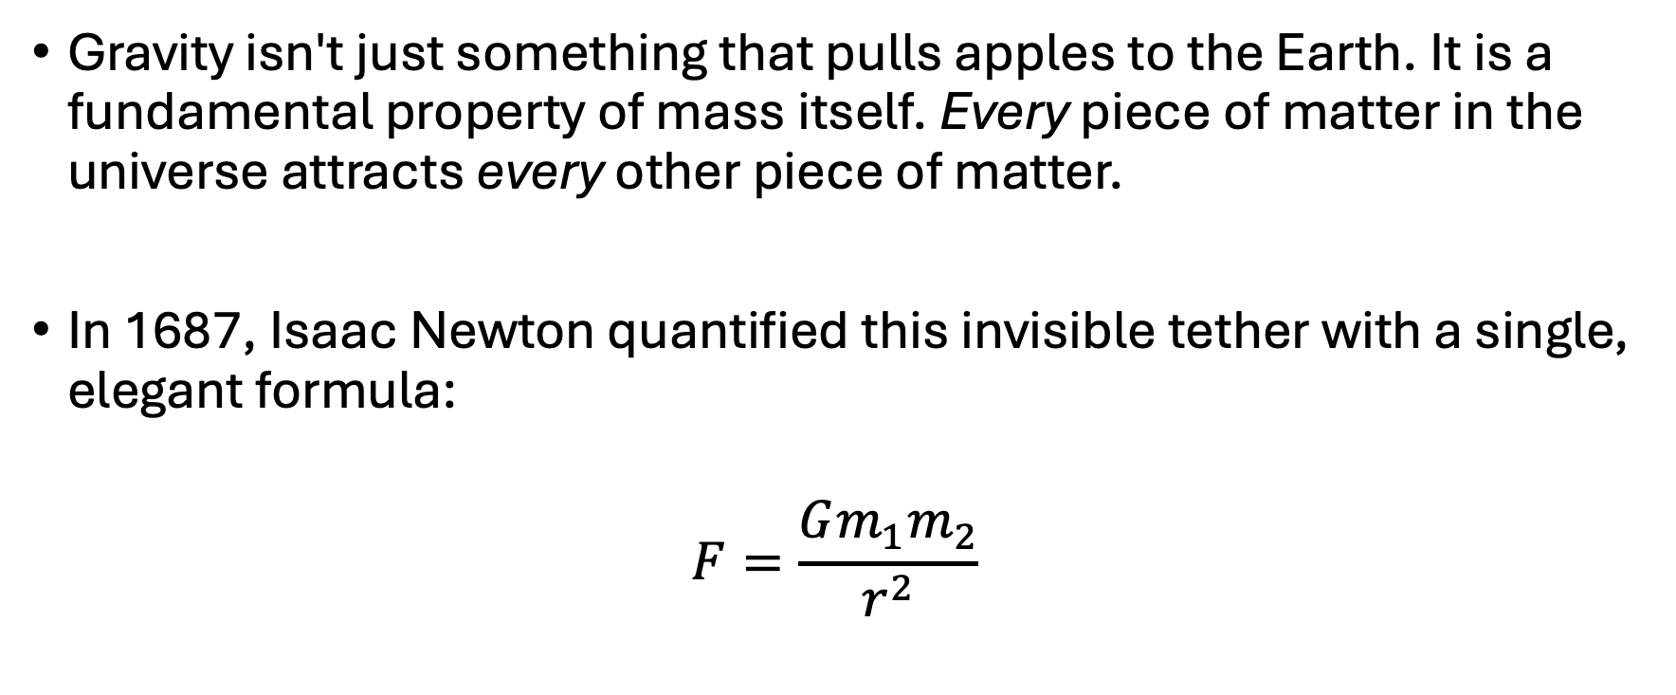
Newton Law’s of Gravitation
Gravity isn't just something that pulls apples to the Earth. It is a fundamental property of mass itself. Every piece of matter in the universe attracts every other piece of matter.
In 1687, Isaac Newton quantified this invisible tether with a single, elegant formula:
$$F=\frac{Gm_{1}m_{2}}{r^{2}}$$

Slide 3
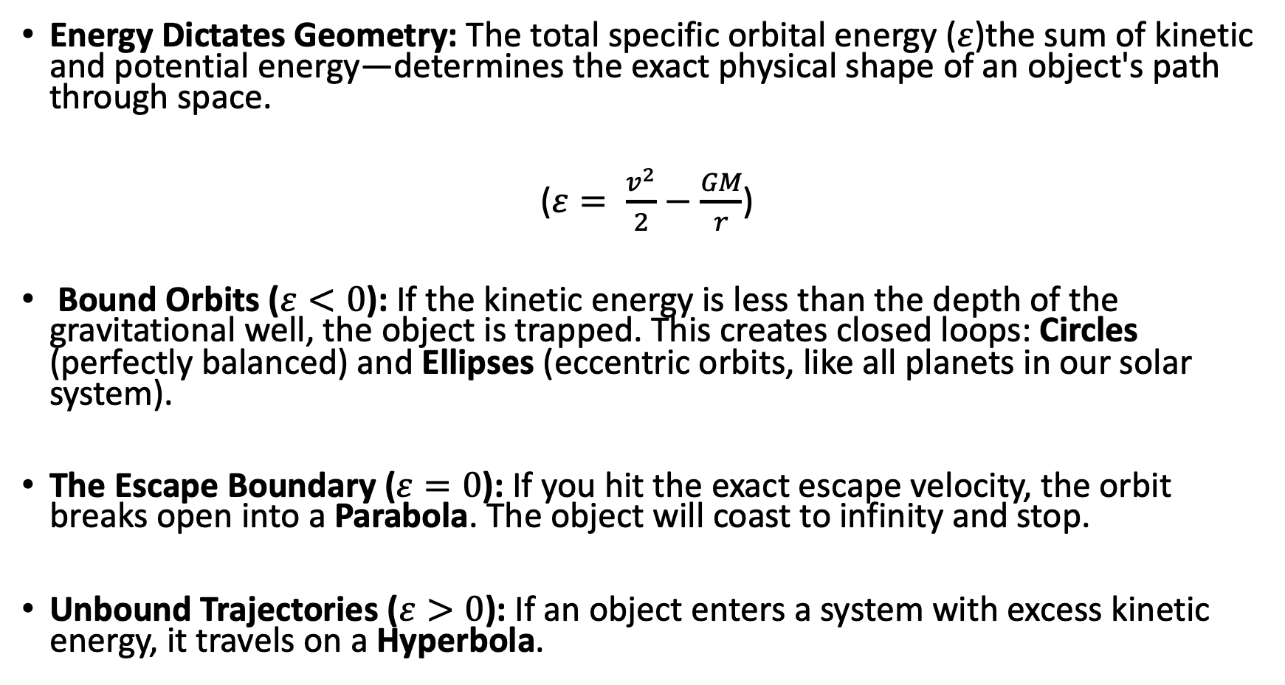
Orbital Mechanics
Energy Dictates Geometry: The total specific orbital energy ($ε$)the sum of kinetic and potential energy—determines the exact physical shape of an object's path through space.
($ε= \frac{v^{2}}{2}−\frac{GM}{r}$)
Bound Orbits ($ε<0$): If the kinetic energy is less than the depth of the gravitational well, the object is trapped. This creates closed loops: Circles (perfectly balanced) and Ellipses (eccentric orbits, like all planets in our solar system).
The Escape Boundary ($ε=0$): If you hit the exact escape velocity, the orbit breaks open into a Parabola. The object will coast to infinity and stop.
Unbound Trajectories ($ε>0$): If an object enters a system with excess kinetic energy, it travels on a Hyperbola.

Slide 4
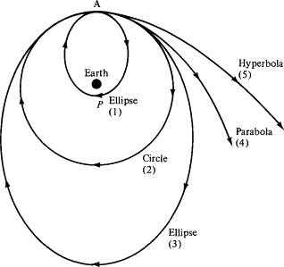

Slide 5
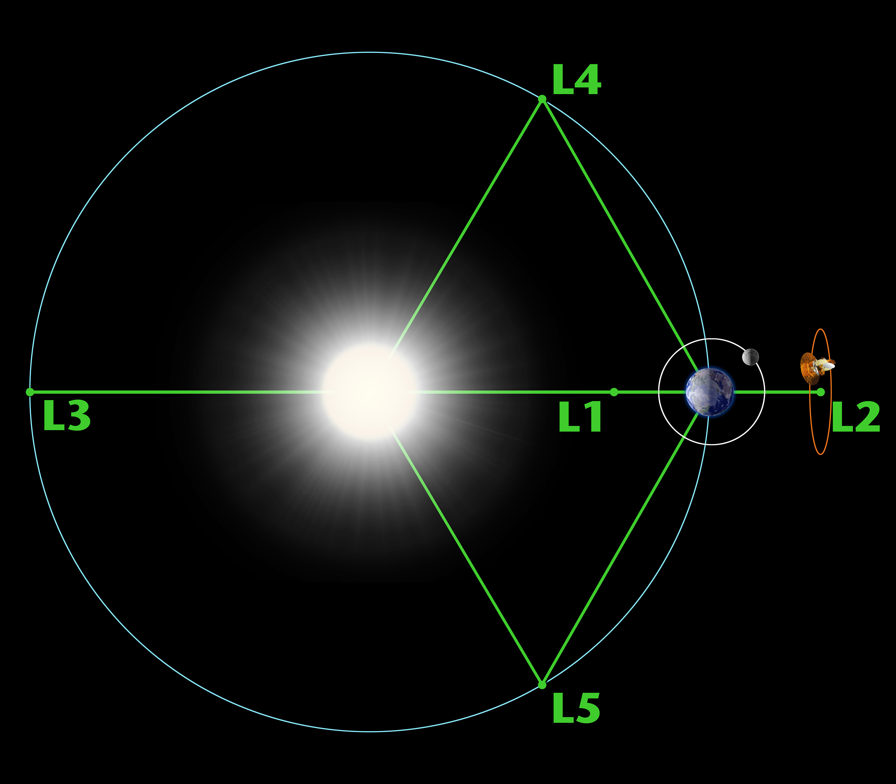
Lagrange Points
Gravitational Equilibrium: Lagrange points occur where gravitational forces of two massive bodies and orbital motion balance perfectly.
Five Special Locations: L1, L2, L3 lie along the line connecting the two bodies. L4 and L5 form equilateral triangles with them.
Stable vs Unstable: L4 and L5 are naturally stable. L1, L2, and L3 require active station-keeping.
Strategic Real Estate: Ideal for space telescopes and observation satellites.
Minimal Fuel Advantage: Objects placed here require very little energy to maintain position.

Slide 6
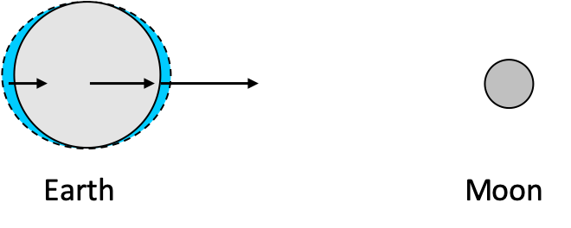
Tidal Forces
Gravity weakens with distance, so the near side of an object feels stronger pull than the far side.
Tidal Bulges: This difference stretches bodies, producing ocean tides on Earth.
Tidal Locking: Over time, rotation synchronizes with orbit, as seen in Earth’s Moon.

Slide 7
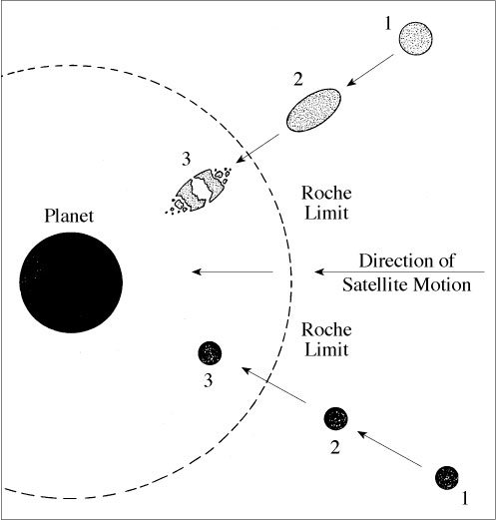
Roche Limit
Definition: The minimum distance at which a satellite can orbit without being torn apart by tidal forces.
Structural Dependence: Rigid bodies survive closer than fluid bodies.
Ring Formation: Planetary rings often form from material inside the Roche limit.
Mathematical Form: Depends on densities of primary and secondary bodies.
Cosmic Sculptor: Explains why moons are absent within certain orbital radii.

Slide 8
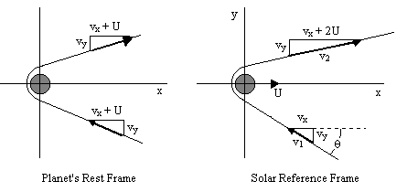
Gravitational Slingshot
Momentum Exchange: A spacecraft can gain or lose orbital energy by passing close to a moving planet.
No Free Energy: The spacecraft steals a tiny amount of the planet’s orbital momentum. The planet slows by an immeasurable amount.
Velocity Boost: In the Sun’s reference frame, the spacecraft exits with greater speed than it entered.
Trajectory Bending: The planet’s gravity curves the path like a cosmic billiards cushion.
Mission Game-Changer: Enables deep space missions without carrying impossible amounts of fuel.

